Slide 1
Semi-supervised image segmentation in a Bayesian framework using RF and CNN: a comparative study
Master Thesis
Advisor: Gregory Paul
May 19, 2017 Prateek Purwar
Notes:
1

Slide 2
Thanks to these people for their support.
Christoph Mayer
Denis Samuylov
Sergi Caelles
Jordi Pont-Tuset

Slide 3
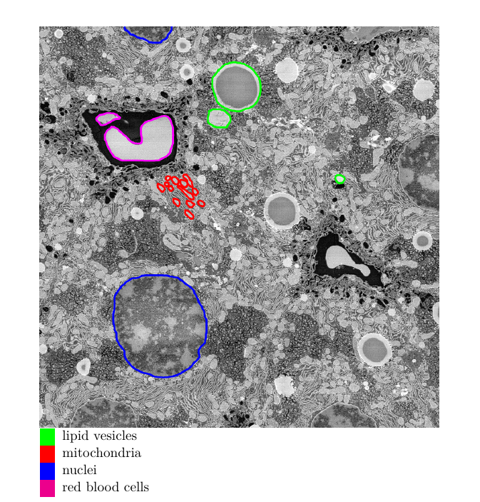
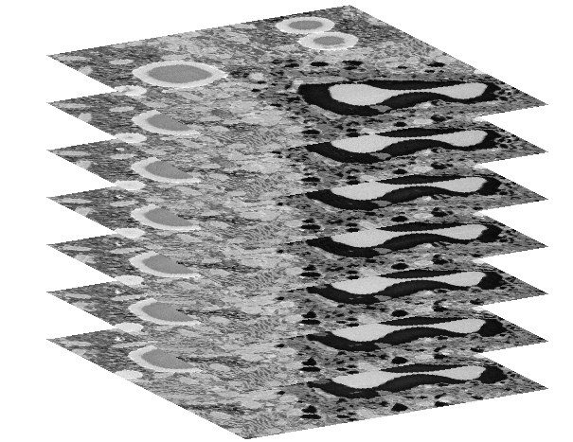
Binary segmentation of histopathology images
3D stack: 450x1890x1952
3

Slide 4
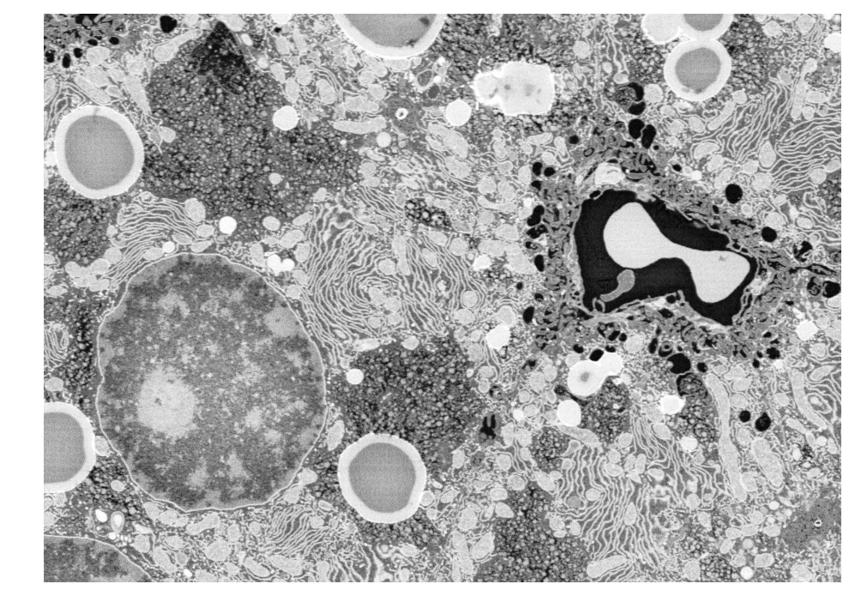
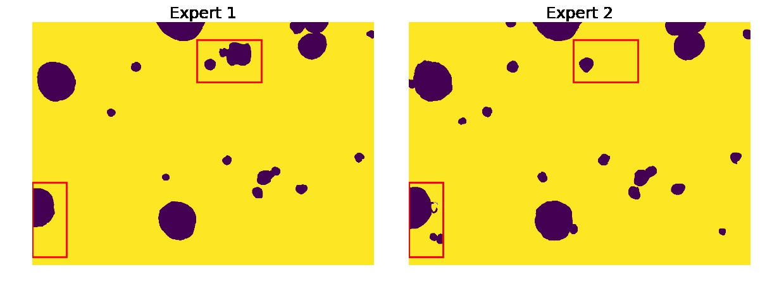
Difficulty in annotation
4

Slide 5
How to segment using limited training data ?
Can we use state-of-art “CNN” ?
5

Slide 6
Use of transfer learning
Pretrained network for segmentation for 3D stacks
Similarity of video and 3D stacks
OSVOS : The network using weights from pre-trained ImageNet for initialization and then fine-tuned for segmentation
One shot video object segmentation (OSVOS)
6

Slide 7
Results
7

Slide 8
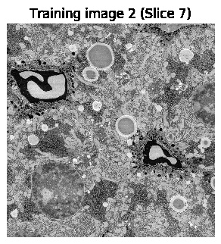
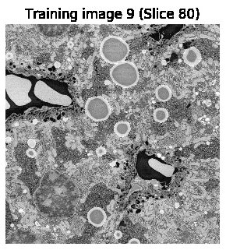

Slide 9
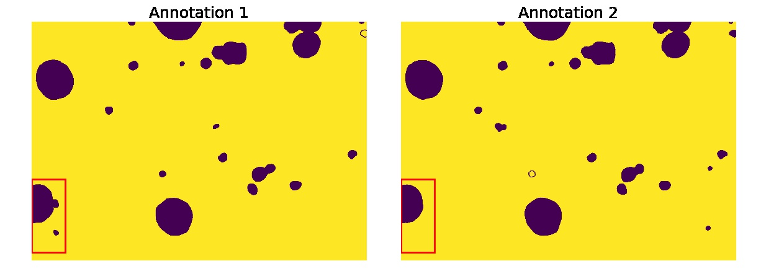
Undefined shapes of objects
9

Slide 10
Can we achieve the same accuracy using partial annotations ?
Use Random forest to learn from scribbles. Methods used by Eugster or Santner
Modify OSVOS to learn from scribbles
Where/what and how much to scribble ?
Quality and Quantity of scribble to achieve best results.
10

Slide 11
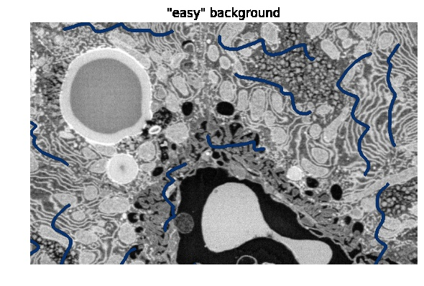
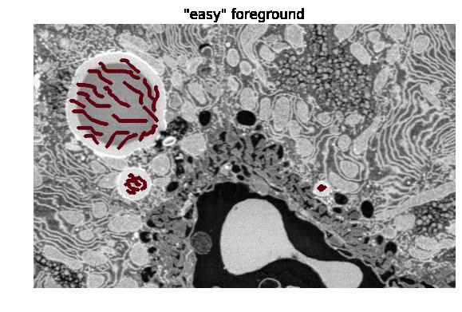
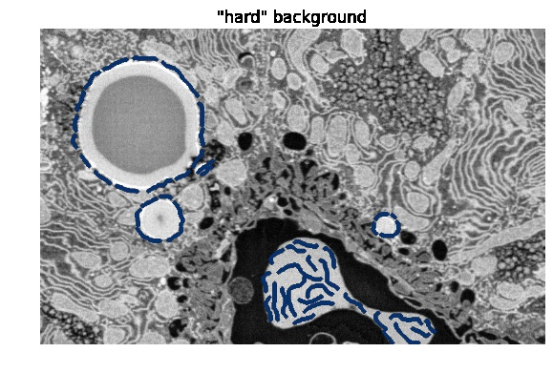
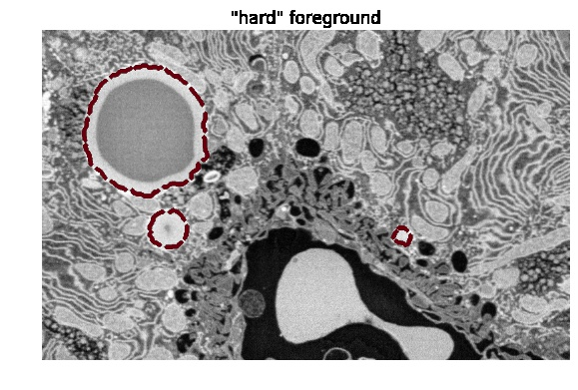
Design of experiment:
11

Slide 12
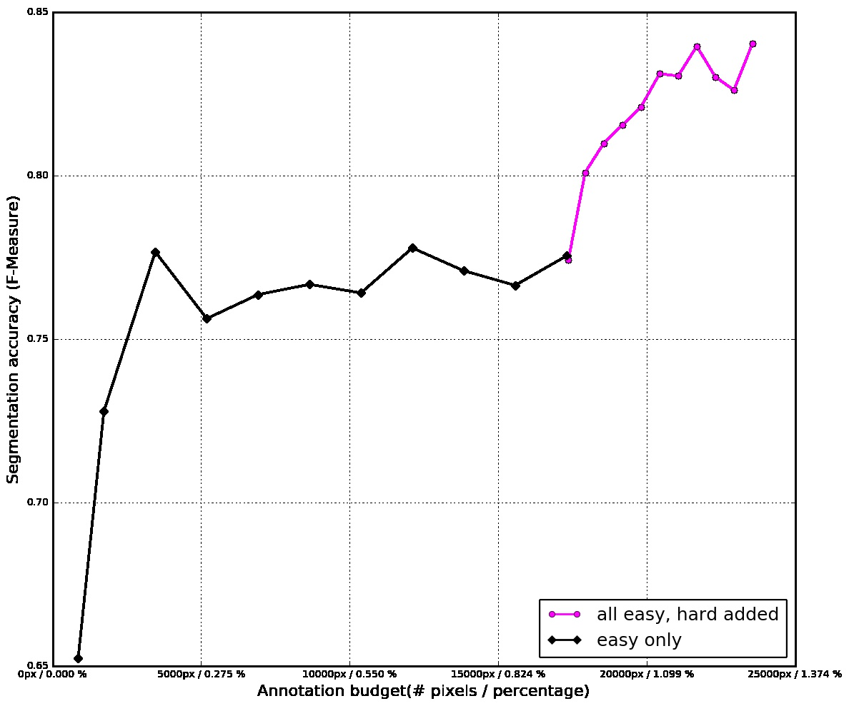
Experiment : additive sampling of scribbles
12

Slide 13
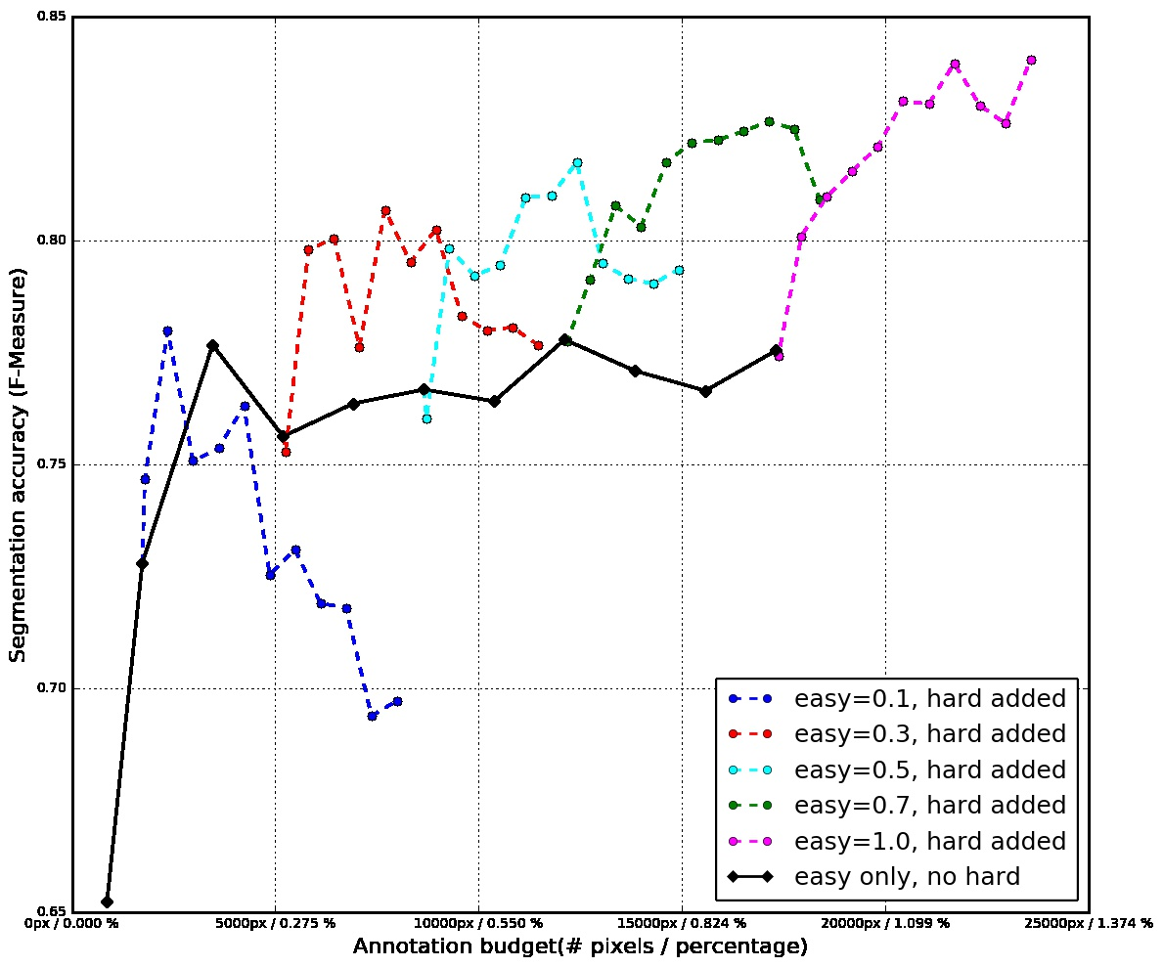
13

Slide 14
How to decide the amount of scribbles?
Iterative Semi-interactive approach
Boundary
Noise
14

Slide 15
Bayesian formulation
Describe formulation
Add anti-log function
15

Slide 16
Observations:
16

Slide 17
Observations:
17

Slide 18
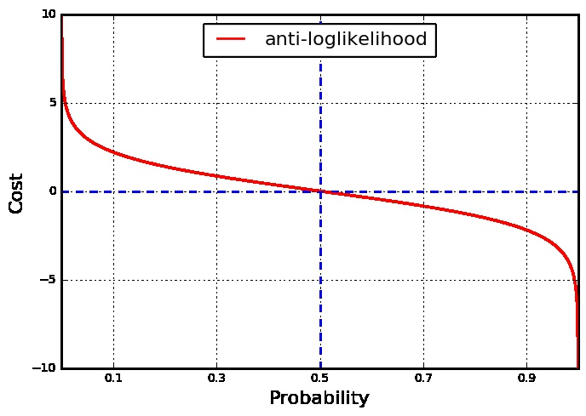
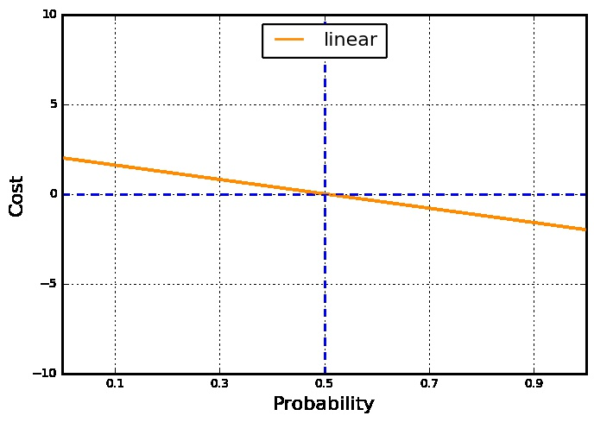
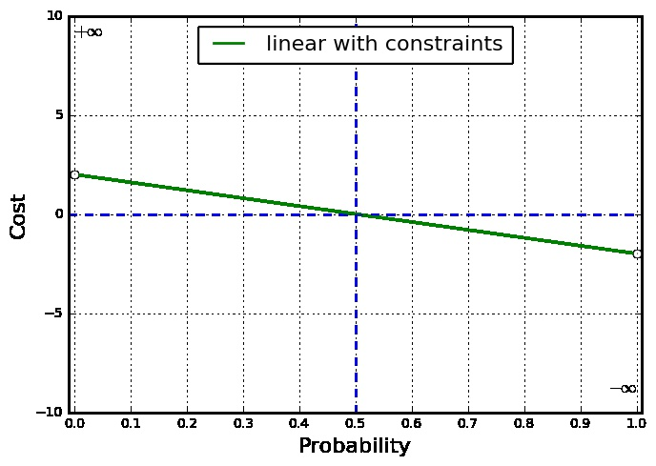
Different cost functions
18

Slide 19
Different cost functions:
random sampling of pixel for training
19

Slide 20
Different cost functions:
random sampling of pixel for training
20

Slide 21
Linear vs Anti-loglikelihood:
21

Slide 22
Feature selection
Layered architecture of CNN
Transfer learning/Multi-tasking
Learning universal principles
Can we replace RF with CNN and train OSVOS from scribbles ?
22

Slide 23
Scribbles loss
Loss computation in CNN:
Similar to inpainting problem, the loss is computed for annotated pixels only. The loss can be written as:
23

Slide 24
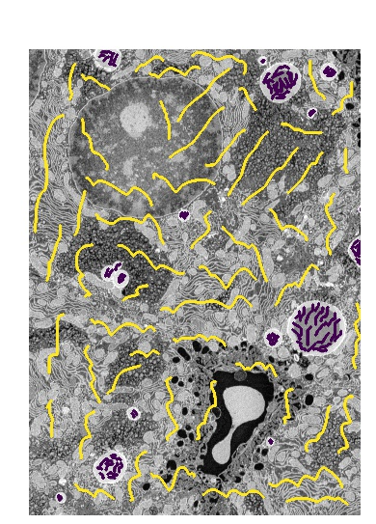
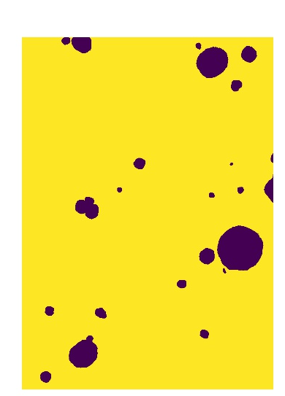
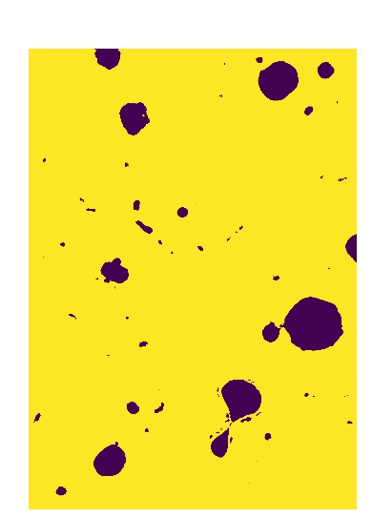
Does Scribble loss works?
Ground Truth
CNN
24

Slide 25
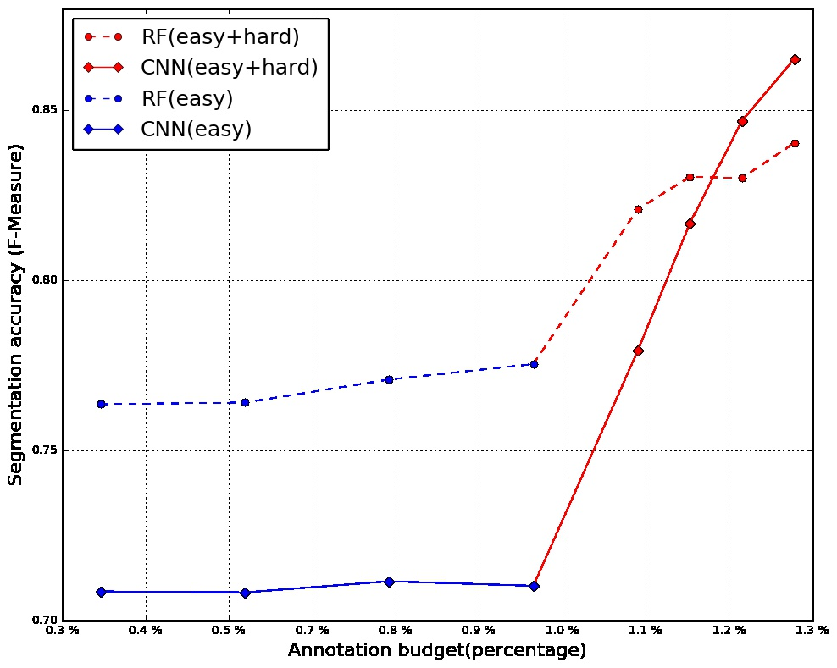
RF vs CNN
25

Slide 26
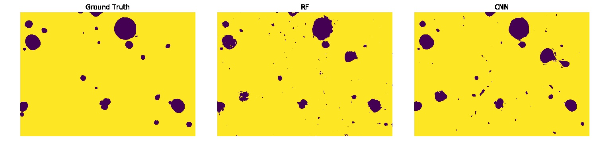
RF vs CNN …
26

Slide 27
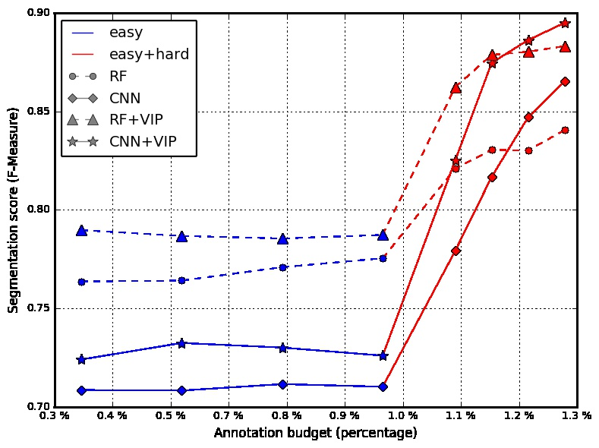
RF vs CNN with VIP
27

Slide 28
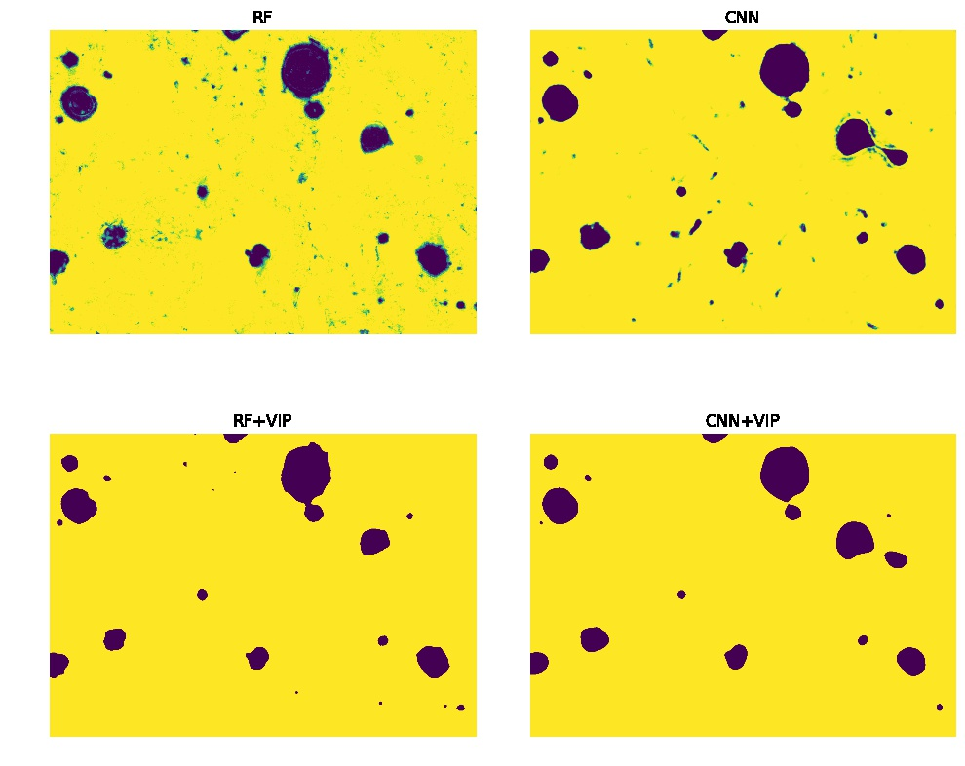
RF vs CNN with VIP ….
28

Slide 29
Conclusion
Transfer learning in CNN is highly advantageous for tasks with limited amount of training data
Variational metods provide a boost in accuracy, if used properly eg. anti-loglikelihood cost function
CNN performs better than RF, when sufficient data is available
Success of scribble loss allows use of pre-trained networks for semi-supervised learning
29

Slide 30
Outlook
Boost obtained from CNN+VIP motivates to couple CNN and VIP together
Layered implementation of VIP
Use of CNN to combine output masks for different lambdas
30

Slide 31
Thank you

